Slide 1
Volunteer Bloomerang Training
Hospitality & Volunteer Coordinator
Christina Anderson

Slide 2
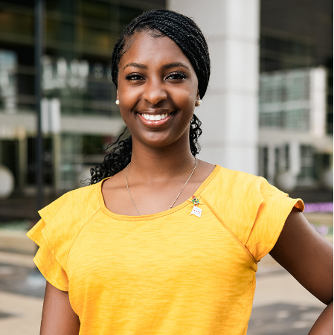
Christina Anderson
CPC Volunteer Coordinator

Slide 3
Agenda
Volunteer criteria
Prizes
Volunteer check in process
Bloomerang app walk through
Volunteer FYI
FAQ

Slide 4
Volunteer Criteria
You have to be registered for the convention as an attendee
Volunteering for the convention alone does not give you free registration or discounted for any hotels/ transportation. For convention travel discounts, please visit convention.nsbe.org
Volunteers that have signed up and completed over 4 hours during the convention duration will receive a special gift upon exit of the convention so show your enthusiasm for volunteering today!
Volunteering events are first come first serve!

Slide 5


Volunteer Prizes

Slide 6
Volunteer Check Ins
Volunteers must be registered for convention and have received their badge
After shift is confirmed, volunteer opens the Bloomerang app to find location for shift
  If you cannot find the location of their shift, you can contact the admin on the Bloomerang app
  If you do not receive assistance then, walk to the volunteer table at convention for on-the-spot assistance
Once volunteer arrives at shift, check in on the app and through event manager
Once event is done, check out for shift and gain your hours!

Slide 7
Bloomerang Walk Through

Slide 8
Volunteer FYI
Kiosk will be available to volunteers not on the app, who need directions, who lost service when checking in or who is interested in signing up for a last minute shift
  Volunteer kiosk located near regular registration tables
Hours will be reviewed and everyone who completes their minimum 4 hours will be contacted to pick up their gift at volunteer table (Friday- Saturday)
Events will be added, removed and modified on a frequent basis. Please check in with your shifts frequently to ensure that the location, date and time is known to you prior to your shift
Some events require training before the event. If you sign up for an event with training prior to, you will be contacted for further instructions

Slide 9
FAQ
Volunteer sign up limit: You can have as many volunteers as you want; You can also set a waitlist limit for volunteers
Checking in: Check in will be through the app based on you geolocation and when you check in
  You will go to your respective areas based on the shift you signed up for and the location shown
Checking out: you can also check out once you’re done with your shift. Your realistic hours will show on their page
TPC, PCI, GSCC has their own pages categorized by certain qualifications based on answers to sign up questions
Check in issues: Opportunity to check in through kiosk (QR code) at volunteer table

